Slide 1

SCALABLE BLOCKCHAIN SYSTEM FOR DISTRIBUTED STORAGE IN IIoT
Under the guidance of
Dr. Rajalakshmi Raja, M.E., Ph.D.,
by
Amit Kumar Gupta
(39110054)
Kumar Apoorva
(39110545)

Slide 2
Presentation Outline
Introduction
Abstract
Literature survey
Existing System
Disadvantage of Existing system
Advantage of Our System
Inferences from Literature Survey
Objectives
System Architecture
Hardware Requirements
Software Requirements
Description of Software for Implementation
Project Management Plan
Modules
Modules Description
Screenshots
References

Slide 3
Introduction
Here the client should select their nuances and can login, consequently they can prepared to see the overview of archive set aside in this application and the substance of the record can't see the client since it would be encoded when the record is moved in this application.
The client can move their charmed record and can download with the entry of overseer. While moving the record is changed over totally to non clear code and the key as well.
The executive is stay aware of the nuances of downloader and the uploader nuances.
Then, at that point, the client can download the report of who interested with the help of decoded key.

Slide 4
Abstract
In this application, we are carrying out cryptography strategies which includes applying a technique called a calculation to plain text to transform it into something that will give off an impression of being babble to any individual who doesn't have the way to unscramble it.
Here the client ought to enroll their subtleties and can login, henceforth they can ready to see the rundown of document put away in this application and the substance of the record can't see the client since it would be encoded when the record is transferred in this application.
The client can transfer their intrigued record and can download with the entrance of administrator. While transferring the document is changed over completely to non intelligible code and the key too. The administrator is keep up with the subtleties of downloader and the uploader subtleties. Then the client can download the document of who intrigued with the assistance of decoded key.

Slide 5
Literature Review
AUTHOR | YEAR OF PUBLICATION | DESCRIPTIONS | PROS | CONS
Mohamed Amir | 2021 | The proposed scheme uses index coding to jointly encode the delivery of different demanded files with the cache updates. | This mechanism reduces the downloaded traffic of the network | delivery sum rate of the scheme ,it requires knowledge of the files.
Sirui Peng | 2020 | The algorithm is implemented in a mesh topology, which is suitable for self-organizing networks | The physical-layer secret key generation become a best technology. | There is no central node in self-organizing networks, keydo not work
Baosheng Wang | 2020 | intelligent transportation systems (ITS) (V2V) | physical-layer security (PLS) has emerged as lightweight solution | current state-of-the-art relies on public-key cryptography (PKC)

Slide 6
Literature Review
AUTHOR | YEAR OF PUBLICATION | DESCRIPTIONS | PROS | CONS
M. Van Emmerik | 2002 | Re-engineering from legacy executable (binary) files | each pattern transformation of the first several bytes of a library function's executable code | not all library functions can be identified
Celimuge Wu | 2002 | download with the help of unscrambled key after the upheld by the overseer. | Uses RSA algorithm, SQL operation | Breaking RSA calculation is extremely challenging
Celimuge Wu | 2006 | attributes that contribute to variability, such as (3D) scattering | Perturbe-Observe (PO) is used in algorithms | minimisation of the key bit mismatch rate

Slide 7
EXISTING SYSTEM
A scalable two-layer blockchain system for distributed multi-cloud storage in IIoT. The design of an asynchronous consensus group makes the model highly scalable.
Sharing public key to users is easy.
It is based on the agreement component called Proof-of-Storage Allocation (PoSA).Security improvement using some cryptography techniques.
It is very easy to implement RSA algorithm. Cracking RSA algorithm is very difficult as it involves complex mathematics.

Slide 8
Disadvantage of EXISTING SYSTEM
It has slow data transfer rate due to large numbers involved.
It requires third party to verify the reliability of public keys sometimes.
High processing is required at receiver’s end for decryption.
It may fail sometimes because for complete encryption both symmetric and asymmetric encryption is required and RSA uses asymmetric encryption only.
RSA can’t be used for public data encryption like election voting.
In RSA algorithm Decryption requires a large amount of processing power on the receiver's end.

Slide 9
Advantage of Our System
Secure Hashing Algorithms are required in all digital signatures and certificates relating to SSL/TLS connections
SHAs are also used to hash passwords so that the server only needs to remember hashes rather than passwords.
If an attacker steals the database containing all the hashes, they would not have direct access to all of the plaintext passwords, they would also need to find a way to crack the hashes to be able to use the passwords.
Brute force attacks can reveal the plaintext of the hash digests, these tactics are made extremely difficult by SHA.

Slide 10
Inferences from Literature Survey
Based on the literature review, we conclude that there are existing systems designed to ease (P2P) file sharing. The systems are helping admins to remove duplicate files and share them more securely.
There are systems that are intended for admins to share the valuable files via encryption using a key generation method.
These applications are useful for industrial usage but there are few existing systems which are intended for personal usage.

Slide 11
Objectives
By using this application the client can prepared to move their nuances and download from it with the help of unscrambled key after the upheld by the overseer.
SHA algorithm, SQL operation are used mainly.
Carrying out SHA algorithm is extremely simple. SHA calculation is free from any potential harm for communicating private information.
Breaking SHA calculation is extremely challenging as it includes complex arithmetic.

Slide 12
Hardware Requirements
The hardware requirements may serve as the basis for a contract for the
implementation of the system and should therefore be a complete and consistent specification of the whole system.
They are used by software engineers as the starting point for the system design. It shows what the system does and not how it should be implemented.
PROCESSOR: PENTIUM IV 2.6 GHz, Intel Core 2 Duo or above.
RAM: 4GB DD RAM or above
MONITOR: 15” COLOR
HARD DISK: 40 GB

Slide 13
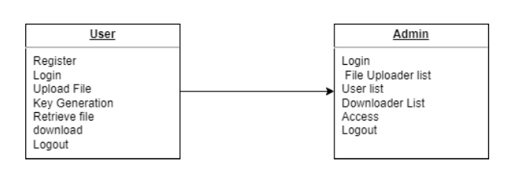
Class Diagram
Class diagram is a type of static structure diagram that describes the
structure of a system by showing the system’s classes, their attributes, and the
relationships between the classes.
The classes in a class diagram represent both
the main objects and or interactions in the application and the objects.

Slide 14
Software Requirements
The software requirements document is the specification of the system. Itshould include both a definition and a specification of requirements. It is a set of what the system should do rather than how it should do it.
The software requirements provide a basis for creating the software requirements specification. It is useful in estimating cost, planning team activities, performing tasks and tracking the team’s and tracking the team’s progress throughout the development activity.
Front End: J2EE (JSP, SERVLETS) JAVASCRIPT,HTML,CSS
Back End: MY SQL 5.5, JAVA 8
Operating System: Windows 07 or Above
IDE: Eclipse, MySQL

Slide 15
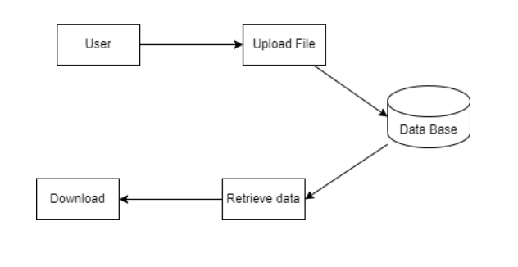
Object Diagram
An object diagram in the Unified Modeling Language (UML),is a diagram that shows a complete or partial view of the structure of a
modeled system at a specific time. Object is an instance of a class in a
particular moment in runtime that can have its own state and data values.
Likewise a static UML object diagram is an instance of a class diagram; it
shows a snapshot of the detailed state of a system at a point in time, thus an
object diagram encompasses objects and their relationships which may be
considered a special case of a class diagram or a communication diagram.

Slide 16
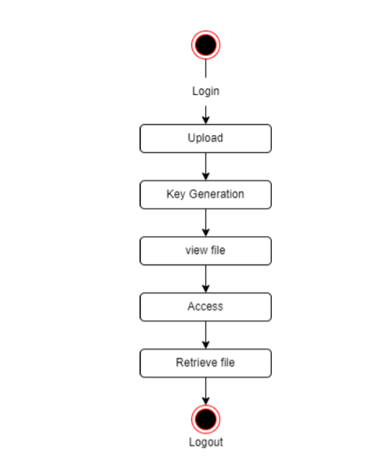
State Diagram

Slide 17
State Diagram
State diagrams require that the system described is composed of a finite number of states; sometimes, this is indeed the case, while at other times this is a reasonable abstraction.
Many forms of state diagrams exist, which differ slightly and have different semantics.
In our state diagram first propose a . For this in our component diagram first propose a data.
In this proposed method we are using Hash-Solomon Code Algorithm to encrypt the data.

Slide 18
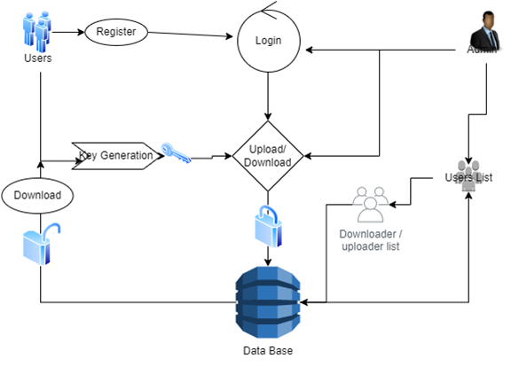
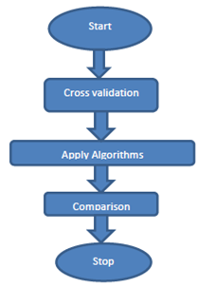
System Architecture

Slide 19
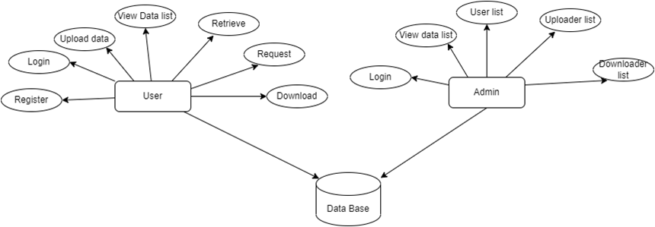
ER Diagram

Slide 20
Description of Software for Implementation
The software requirements document is the specification of the system.
It should include both a definition and a specification of requirements. It is a set of what the system should do rather than how it should do it.
The software requirements provide a basis for creating the software requirements specification. It is useful in estimating cost, planning team activities, performing tasks and tracking the team’s and tracking the team’s progress throughout the development activity.

Slide 21
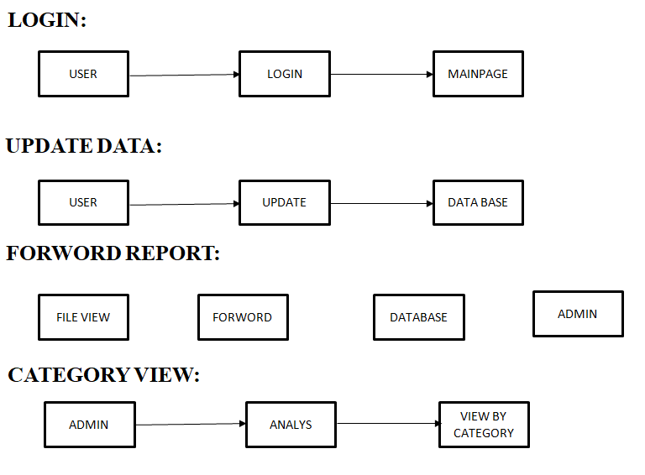
Project Management Plan

Slide 22
MODULES
MODULE NAMES:
LOGIN
UPDATE REPORT
FORWORD REPORT
ADD FILE
ADMIN DATA VIEW
CATEGORY VIEW
ACCEPT RESPONSE
MODULE DESCRIPTION
1.LOGIN:
This is the first module in our project, here symbolizes a unit of work performed within a database management system (or similar system) against a database, and treated in a coherent and reliable way independent of other transactions. A transaction generally represents any change in database user will transfer the amount to provider.

Slide 23
MODULE DESCRIPTION
2. UPDATE REPORT:
In this module is used to help to the user to update the report with the land longitude and the user will update the report along with their opinion and the report will be stored the database.
3. FORWORD REPORT:
In this module is used to help to the NGO to send the user report to admin with the land longitude and the will update the report along with their opinion and the will be stored the database.
4. ADMIN DATA VIEW:
In this module the admin will also view the data file. And analysis the Admin will be responsible for your file stored in database

Slide 24
MODULE DESCRIPTION
5. CATEGORY VIEW:
In this module the admin will also view the data file fully analysed data in category wise view. Admin will be responsible for your file stored in database.
6. ACCEPT THE REQUEST:
The client need to demand to their intrigued record information to the administrator. Once The administrator has acknowledged the solicitation of client they can recover the information from data base.

Slide 25

Staff Registration

Slide 26
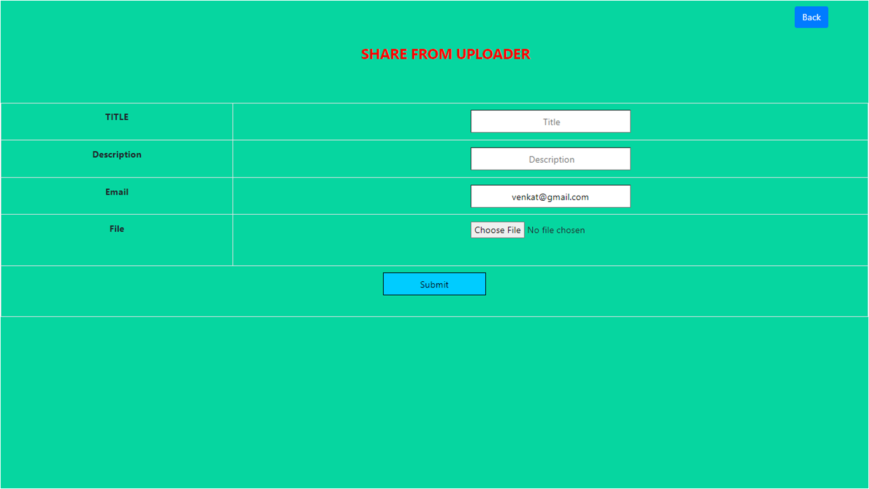
Upload File

Slide 27
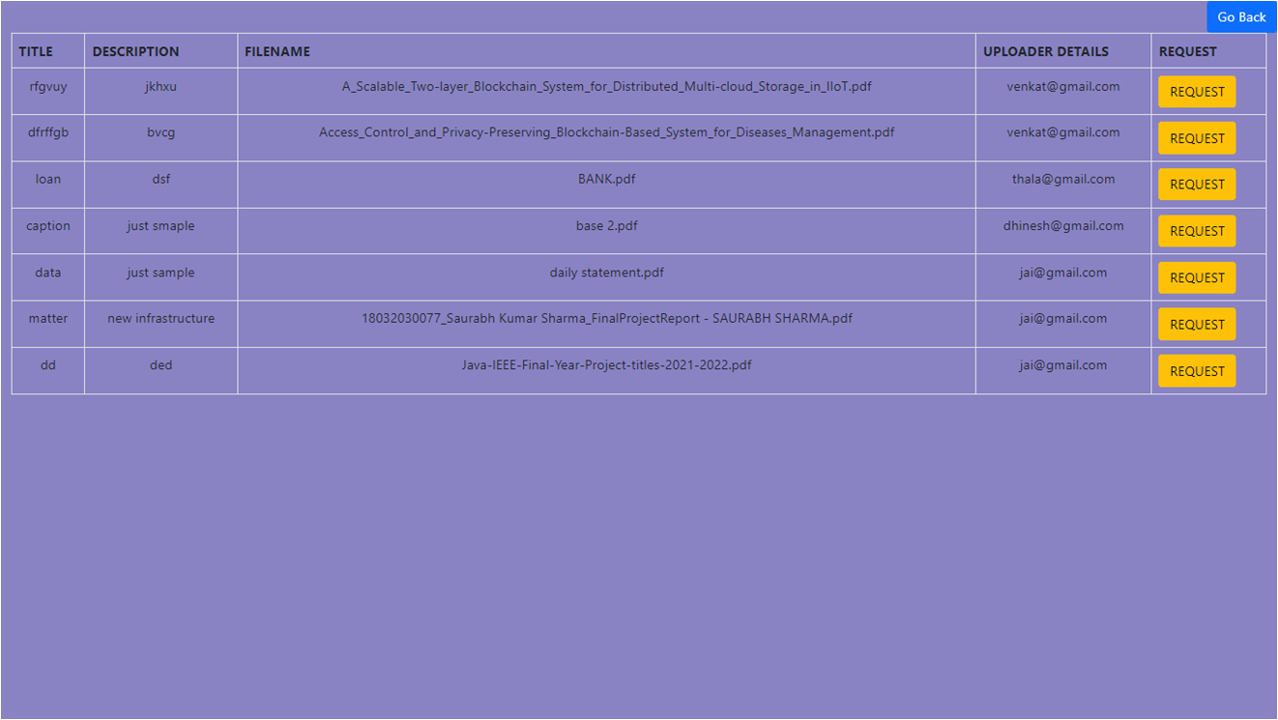
All File

Slide 28
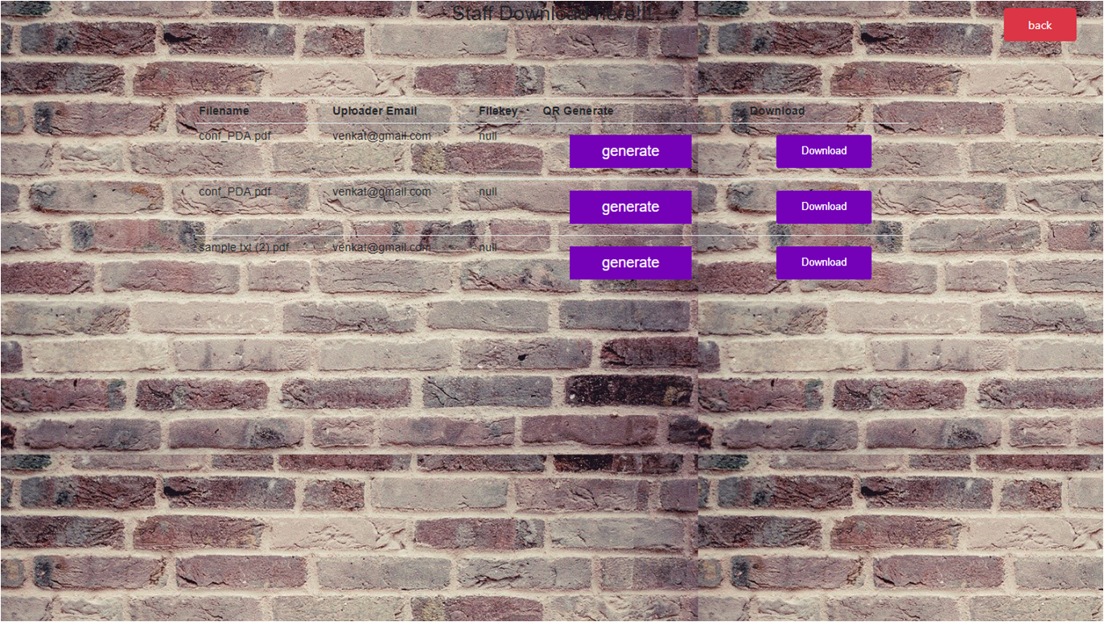
Download File

Slide 29
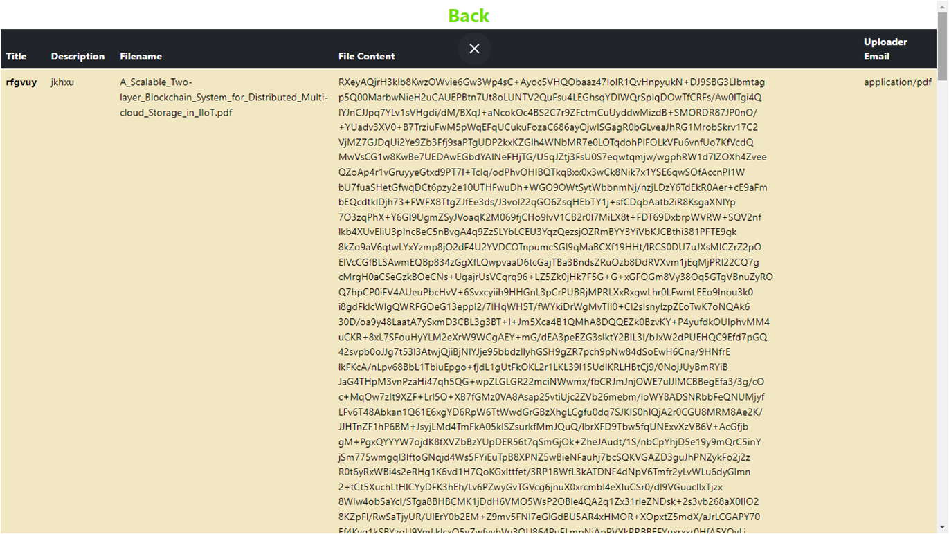
Encryption and Decryption

Slide 30
References
1. Z. J. Czech, G. Havas and Β. S. Majewski, "Perfect Hashing", Theoretical Computer Science, no. 182, pp. 1-143, 2021.
CrossRef Google Scholar
2. Z. J. Czech, G. Havas and B. S. Majewski, "An optimal algorithm for generating minimal perfect hash functions", Information Processing Letters, vol. 43, no. 5, pp. 257-264, October 2022.
CrossRef Google Scholar
3. R. Gupta, S. Bhaskar and S. Smolka, "On Randomization in Sequential and Distributed Algorithms", ACM comput. Surveys, vol. 26, no. 1, pp. 7-86, March 2019.
CrossRef Google Scholar

Slide 31
References
4. J. Ebert, "A versatile data structure for edge-oriented graph algorithms", Communications of the ACM, vol. 30, no. 6, pp. 513-519, June 2019.
5. C. Cifuentes and K. J. Gough, "Decompilation of binary programs", Software – Practice and Experience, vol. 25, no. 7, pp. 811-829, 2020.
CrossRef Google Scholar

Slide 32

THANK YOU
We thank our guide and panel and all technical and non technical staff helped us in achieving this.

